Slide 1
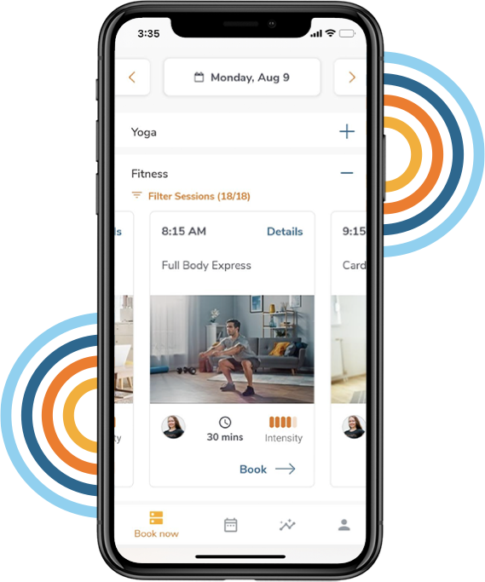
At <Your Company> your well-being is a priority!
You’re invited to de-stress during the workday.
You now have access to Bright Breaks - 300+ live, weekly micro-breaks that help you get up, unwind and feel better. With Bright Breaks you have access to:
Unlimited live break access, early morning, day and evening
Breaks as short as 7 minutes
Cooking, Nutrition & Keynote breaks
Stretching, Mindfulness & Exercise breaks
Daily Break: automated calendar-delivered breaks!
Win prizes in weekly challenges
Access via web or mobile browser
Personal tracking of class attendance
Stop leaving your well-being to chance.
Sign up here with your work email: brightbreaks.com/signup
brightbreaks.com

