Slide 1
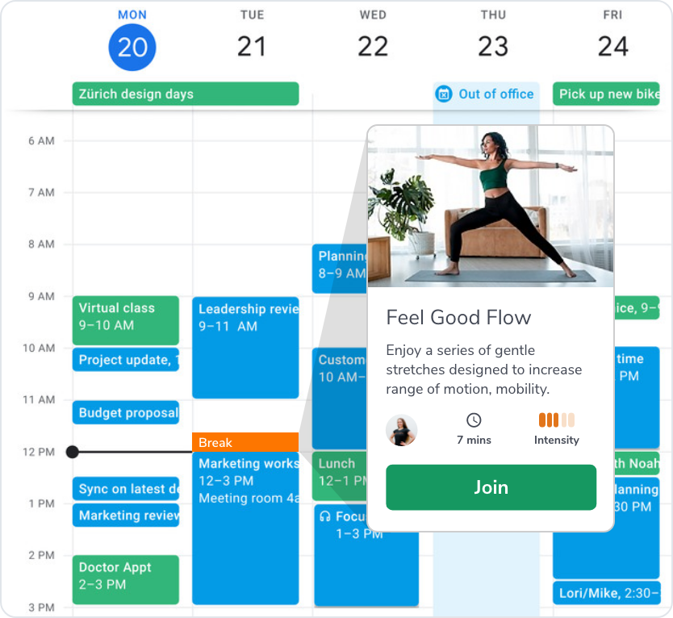
On a mission to inspire and prioritize employee well-being.

Slide 2
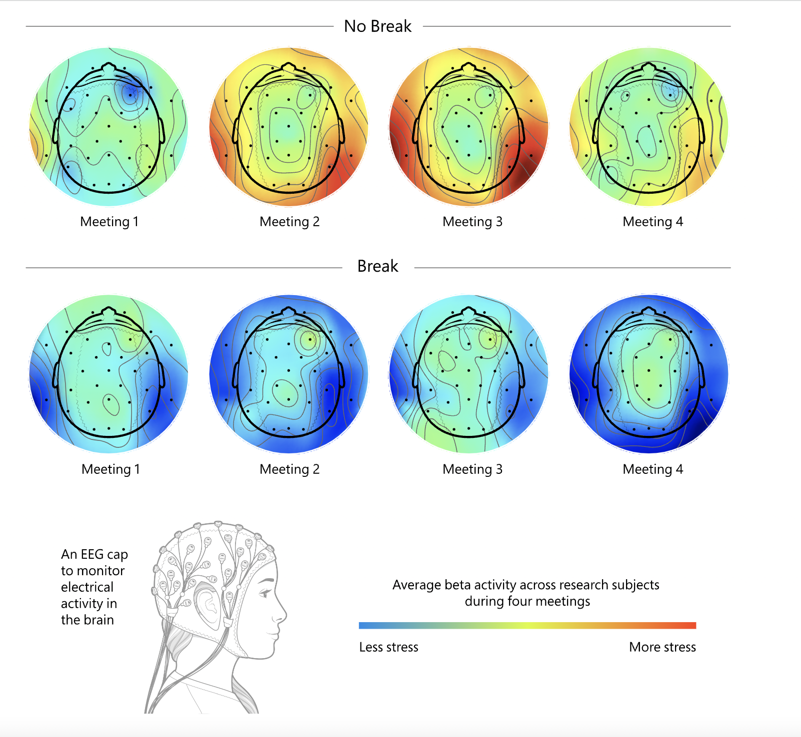
The research on taking breaks is where research on sleep was 10 years ago.

Slide 3
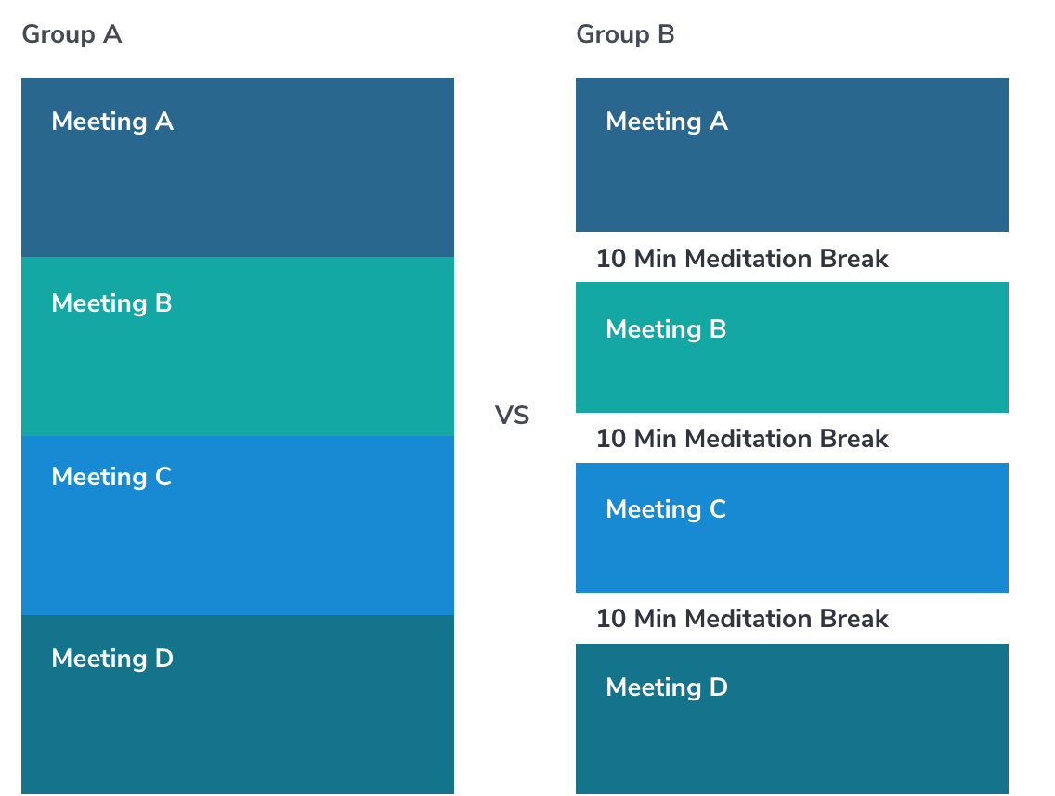
The Research
Research Proves Your Brain Needs Breaks to Reduce Stress and Improve Performance
Notes:
Research Proves Your Brain Needs Breaks. (2021, April 20). www.microsoft.com. https://www.microsoft.com/en-us/worklab/work-trend-index/brain-research

Slide 4
Conclusions
Breaks between meetings allow the brain to “reset,” reducing a cumulative buildup of stress across meetings.

Slide 5
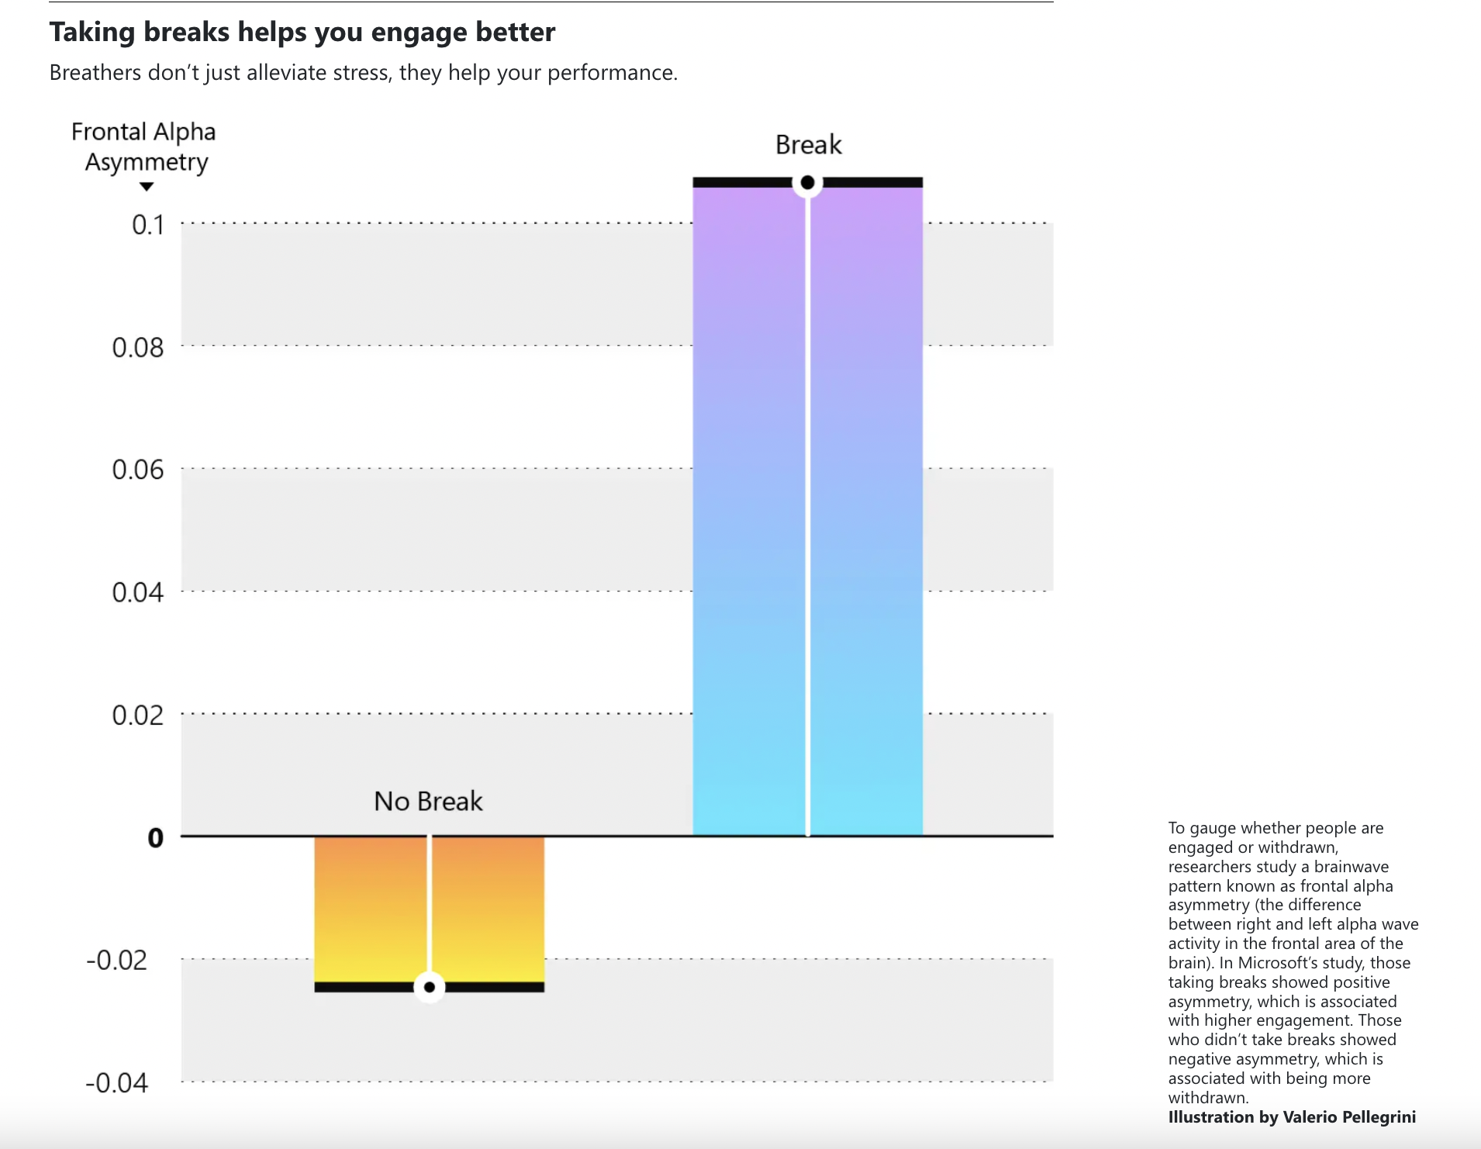
Conclusions
Back-to-back meetings can decrease your ability to focus and engage.

Slide 6
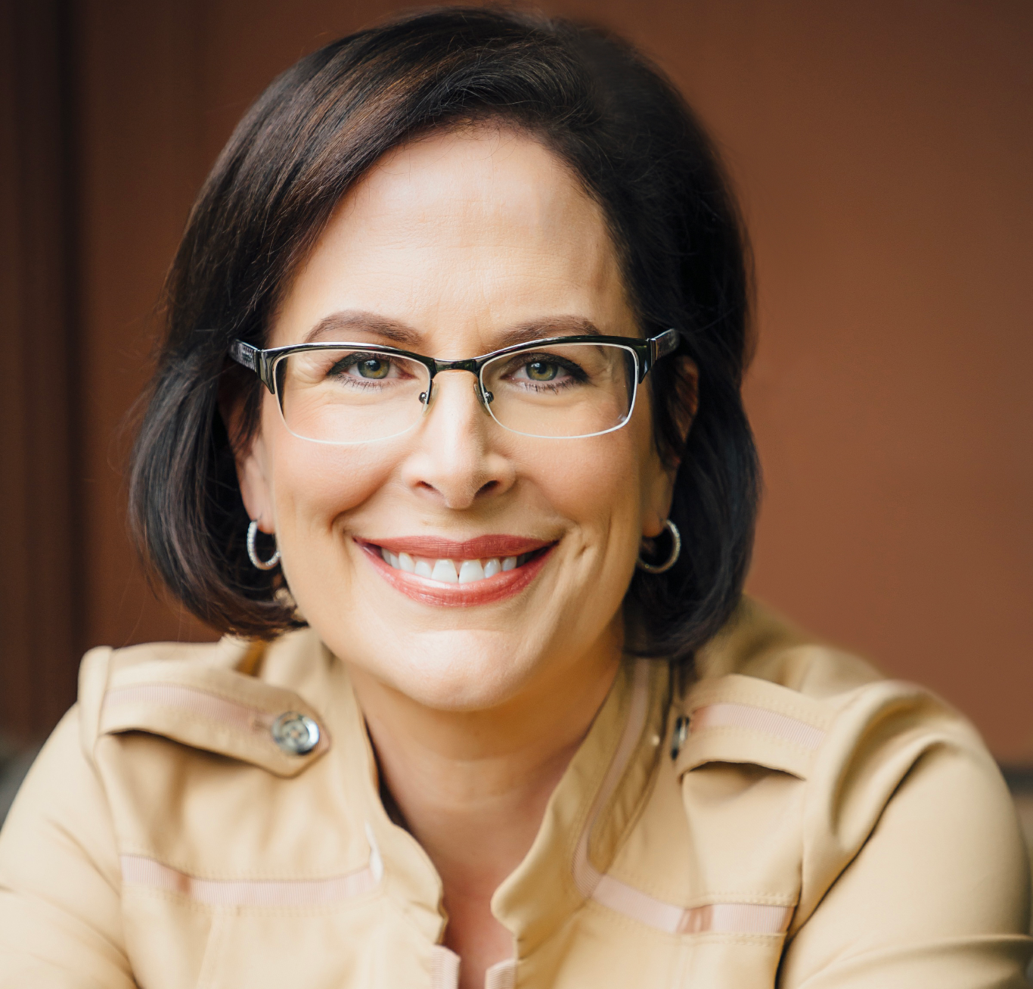
“
In today’s world of remote and hybrid work, it’s not sufficient to only encourage self-care. We need to innovate and leverage technology to help employees operationalize much-needed breaks into their daily routines.”
— Kathleen Hogan, Chief People Officer at Microsoft

Slide 7
A study by the Draugiem Group found that the 10% of highest performers took the most breaks, averaging 17 minutes of break time for every 52 minutes worked.
Notes:
How the Most Productive People Schedule Their Day. (n.d.). The Muse. https://www.themuse.com/advice/the-rule-of-52-and-17-its-random-but-it-ups-your-productivity

Slide 8
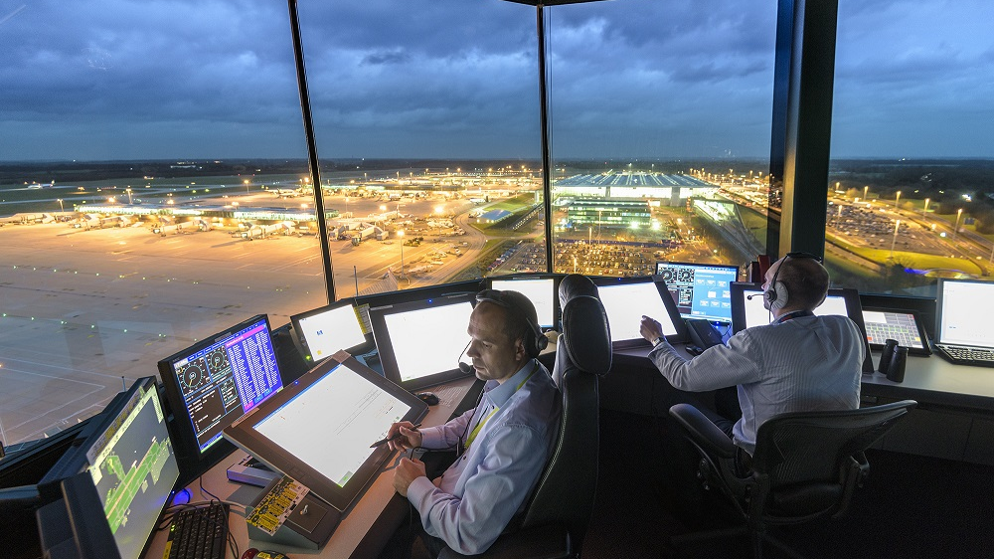
“The Most Stressful Job In The World”

Slide 9
Air Traffic Controllers
Responsible for thousands of lives every day Breaks are mandated by the Federal Aviation Administration
They work no more than one and a half to two hours at a time before they must have a 30 minute break.
Notes:
Bureau of Labor Statistics, U.S. Department of Labor, Occupational Outlook Handbook, Air Traffic Controllers,
at https://www.bls.gov/ooh/transportation-and-material-moving/air-traffic-controllers.htm (visited June 06, 2023).

Slide 10
1/3
61%
of Americans report being lonely
of young people report serious isolation.
Loneliness kills, and Americans are spending too much time by themselves
Loneliness increases risk of cognitive decline, chronic illnesses, and death.
Notes:
CDC. (2021, April 29). Loneliness and Social Isolation Linked to Serious Health Conditions. Www.cdc.gov; CDC. https://www.cdc.gov/aging/publications/features/lonely-older-adults.html
‌

Slide 11
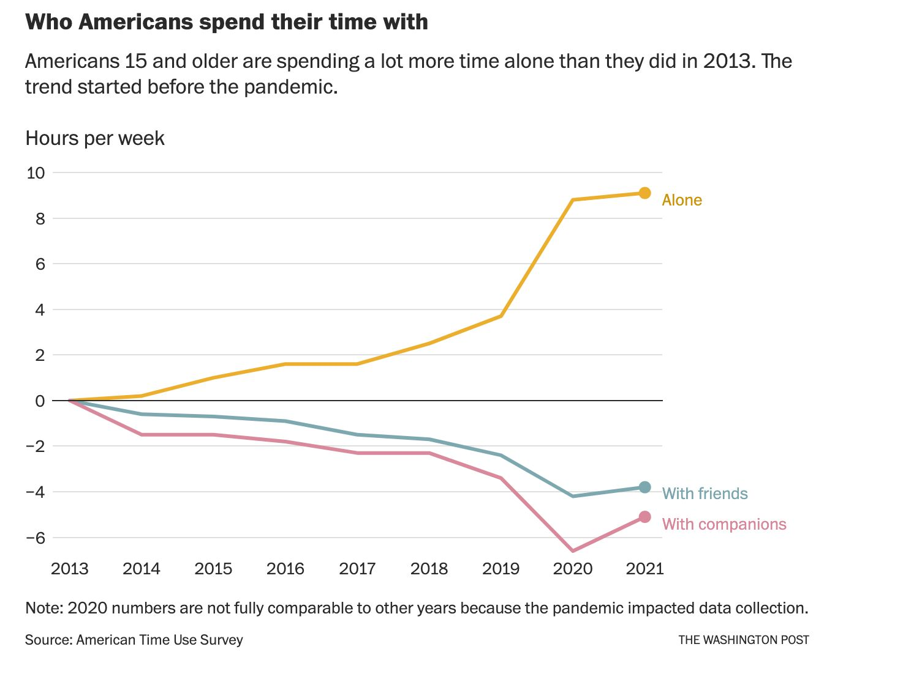
Harvard Data
More telling, an 80-plus-year Harvard study found that embracing community and relationships helps us live longer and be happier.
As the study’s principal researcher George Vaillant puts it:
“The key to healthy aging is relationships, relationships, relationships.”
Beyond diet, exercise, sleep, and other essentials, prioritizing community and social experiences is an investment in good health.
Notes:
Graph: Ward, Bryce. “Opinion | We Are Spending Scary Amounts of Time Alone. Can We Stop Ourselves?” Washington Post, 23 Nov. 2022, www.washingtonpost.com/opinions/2022/11/23/americans-alone-thanksgiving-friends/
Mineo, L. (2017, April 11). Good genes are nice, but joy is better. Harvard Gazette; Harvard Gazette. https://news.harvard.edu/gazette/story/2017/04/over-nearly-80-years-harvard-study-has-been-showing-how-to-live-a-healthy-and-happy-life/

Slide 12
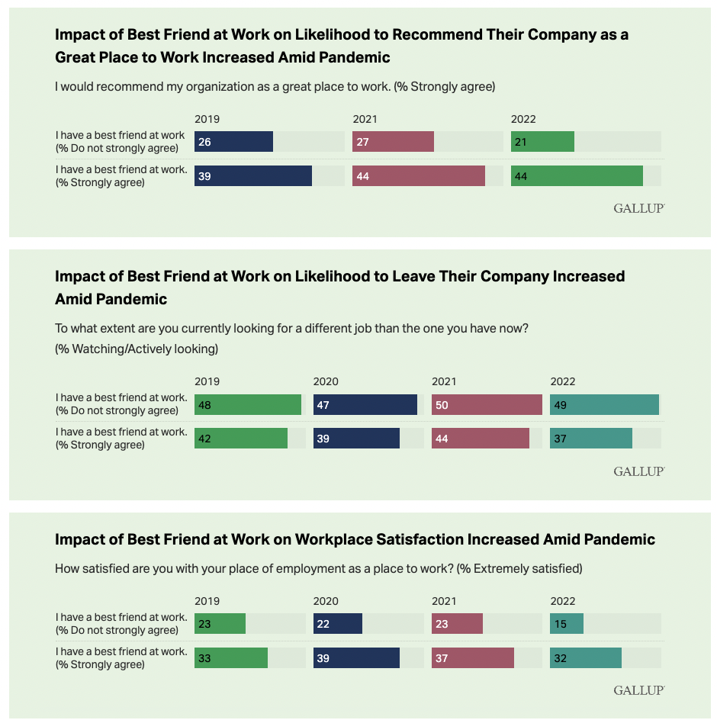
Having a Best Friend at Work Results in Happy and Retained Employees.
Gallup has repeatedly shown that having best friends at work is key to employee engagement and job success. Gallup data indicate that having a best friend at work is strongly linked to business outcomes, including profitability, safety, inventory control and retention.
Employees who have a best friend at work are significantly more likely to:
engage customers and internal partners
get more done in less time
support a safe workplace with fewer accidents and reliability concerns
innovate and share ideas
have fun while at work
Notes:
Inc, G. (2022, August 17). The Increasing Importance of a Best Friend at Work. Gallup.com. https://www.gallup.com/workplace/397058/increasing-importance-best-friend-work.aspx

Slide 13
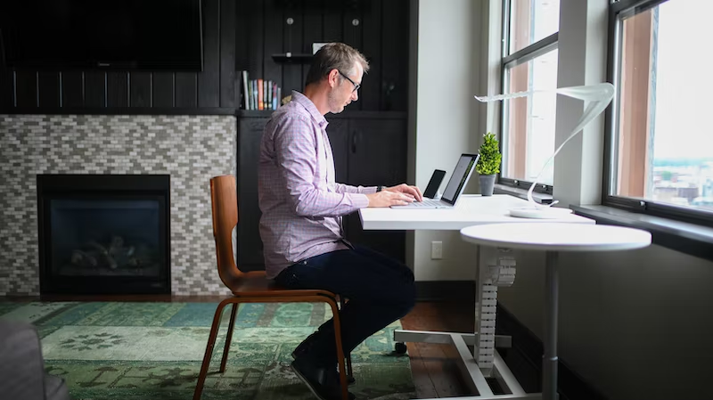
Is sitting is the new smoking?

Slide 14
Mayo Clinic
Researchers analyzed 13 studies of sitting time and activity levels.
They found that those who sat for more than eight hours a day with no physical activity had a risk of dying similar to that posed by obesity and smoking.
Notes:
Sitting risks: How harmful is too much sitting? (2022). Mayo Clinic. https://www.mayoclinic.org/healthy-lifestyle/adult-health/expert-answers/sitting/faq-20058005#:~:text=Researchers%20analyzed%2013%20studies%20of
‌

Slide 15
Mayo Clinic
The study found that people who sit the most, compared to people who sit the least, have a greater risk of disease and death:
112% increased risk of diabetes
147% increased risk of cardiovascular events like heart attack and stroke
90% increased risk of death from cardiovascular events

Slide 16
Problems
Three in 10 employees don’t take a lunch break when working from home.
29% don’t take any meal breaks during the workday.
Six in 10 feel guilty for taking any kind of break during work hours.
Stanfords research shows that work-from-home is associated with two more hours per day spent sitting.

Slide 17
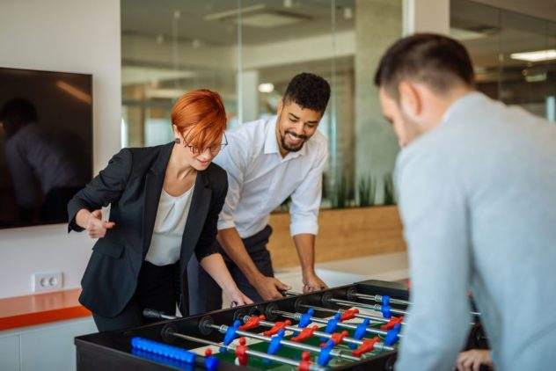
Breaks need to be re-imagined for our new work environments

Slide 18
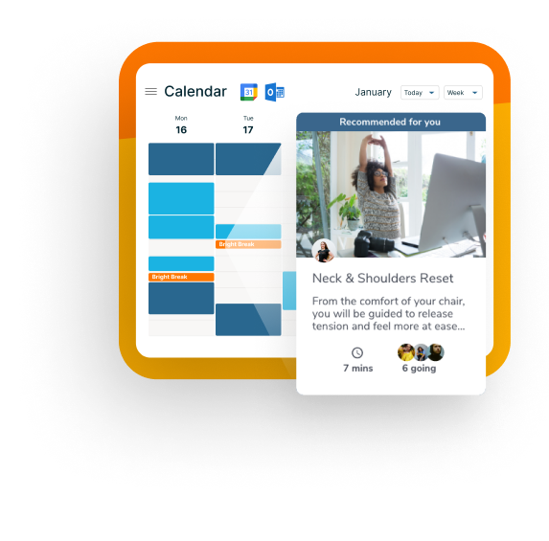
Companies need to rely on technology to motivate and incentivize breaks into employees daily routines.

Slide 19
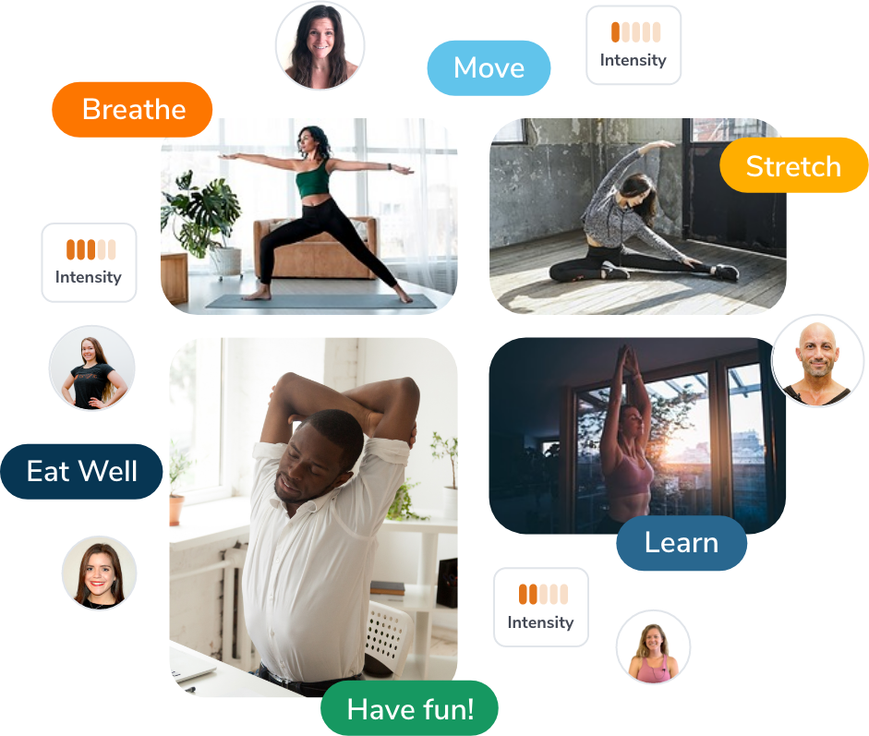
Solution
Bright Breaks is how employees take breaks in a WFH and hybrid world.
With Bright Breaks, companies and their teams get access to over 300 and interactive 7-minute wellness breaks each week. Bright’s novel recommender technology suggests relevant breaks in employees calendars based on: · Interests · Availability · Behavior · Social connections. Each week, employees can earn points, status, and win prizes for prioritizing taking breaks with Bright Breaks.

Slide 20
Single Commonality Amongst:
The most productive employees The least stressed employees
The healthiest employees

Slide 21
It turns out there is
They all take regular breaks at work

Slide 22
In 10 years, companies will view employees taking breaks the same way they view taking vacation time.

Slide 23
Taking breaks at work will be the rule, not the exception.

